Slide 1
The unseen causes of depression
Team members:
Valentina, Ivanna & Tahora

Slide 2
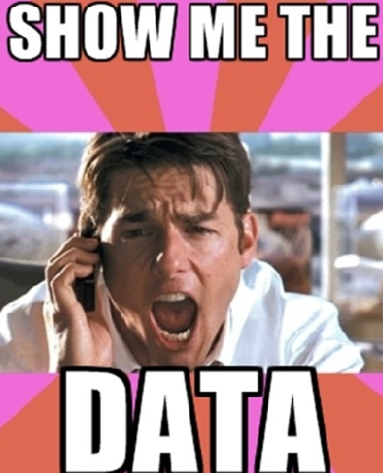
Objective
To understand how development indicators do or do not influence the prevalence of depression in a country.
Target Feature (Y) =
percentage of the population that presented a depressive episode in the last year.
Predictor Variables (X) =
Corruption score
Average temperature
Income inequality
Unemployment
Family size
Public services
Crime rate
Gender gap
Literacy rate
Democracy score

Slide 3
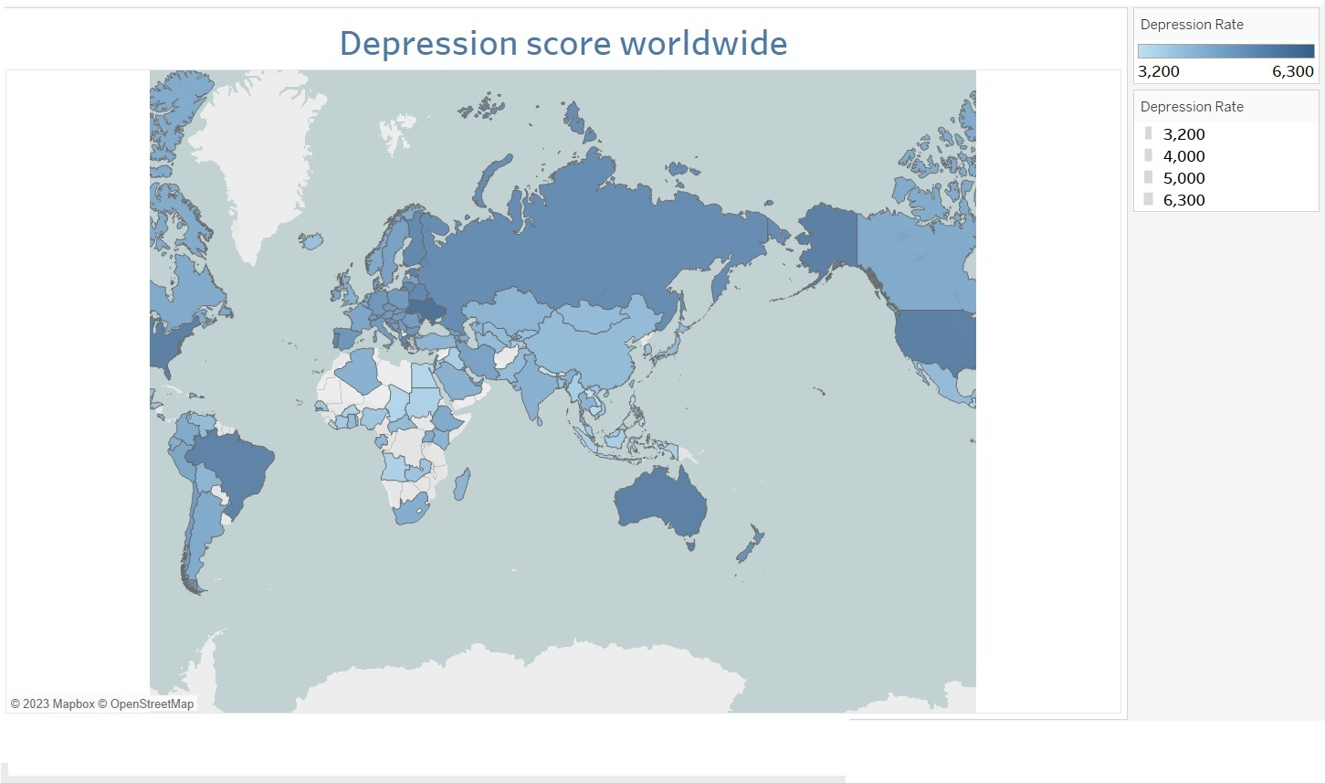
Highest rate: Ukraine (6.3)
Lowest rate:
Laos (3.2)
Global AVG: 3.9

Slide 4
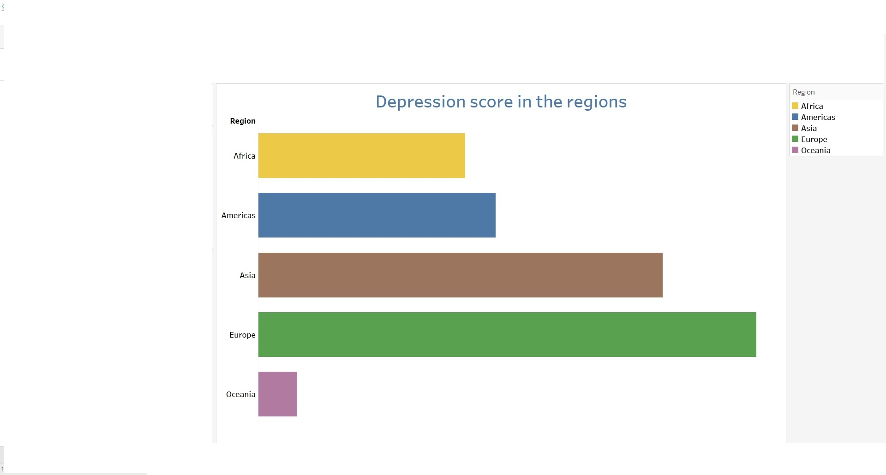

Slide 5
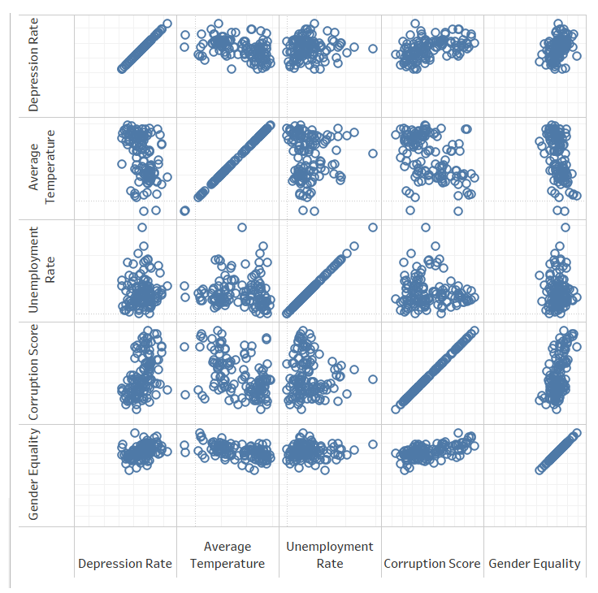
Correlation Matrix (Tableau)

Slide 6
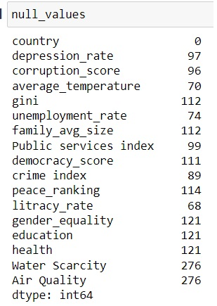


Processing the Data
To Drop or Not to Drop!
From the 195 countries, we dropped almost one third, as 70% of the columns were missing
We chose to fill the NaN with AVG of regions
Air quality: The only categorical feature

Slide 7
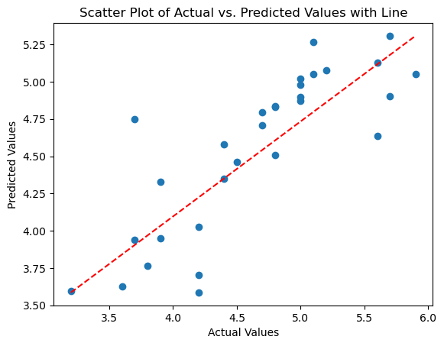
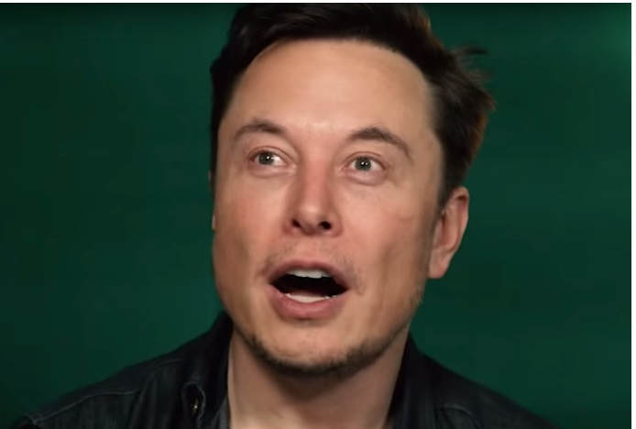
Our Model (Linear Regression)
MAE: 0.277
R²: 0.652

Slide 8
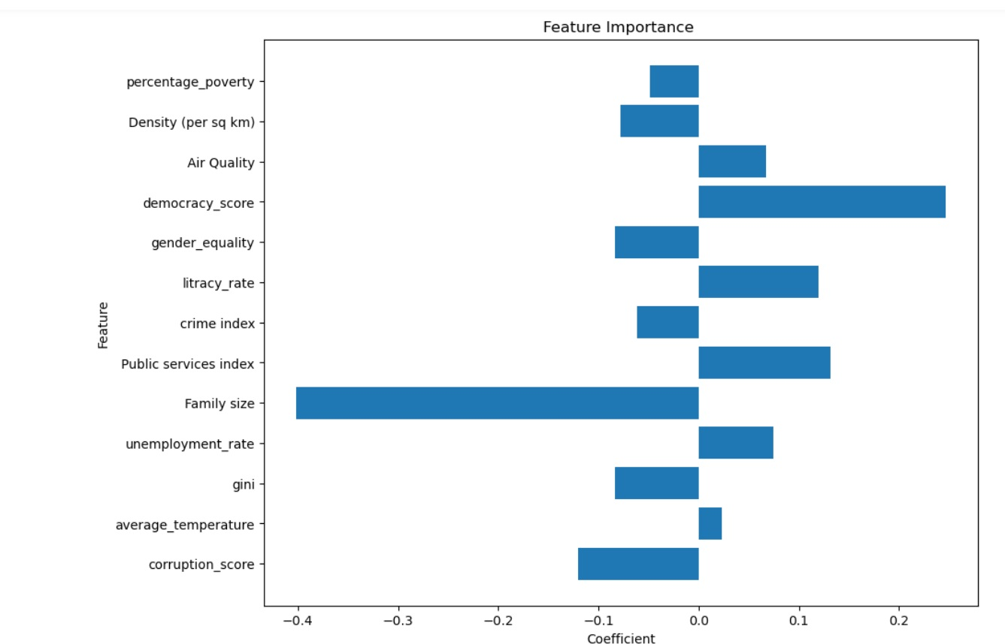
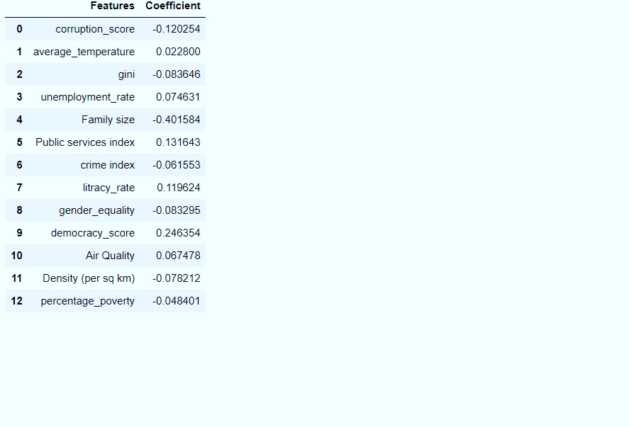
Feature Importance

Slide 9
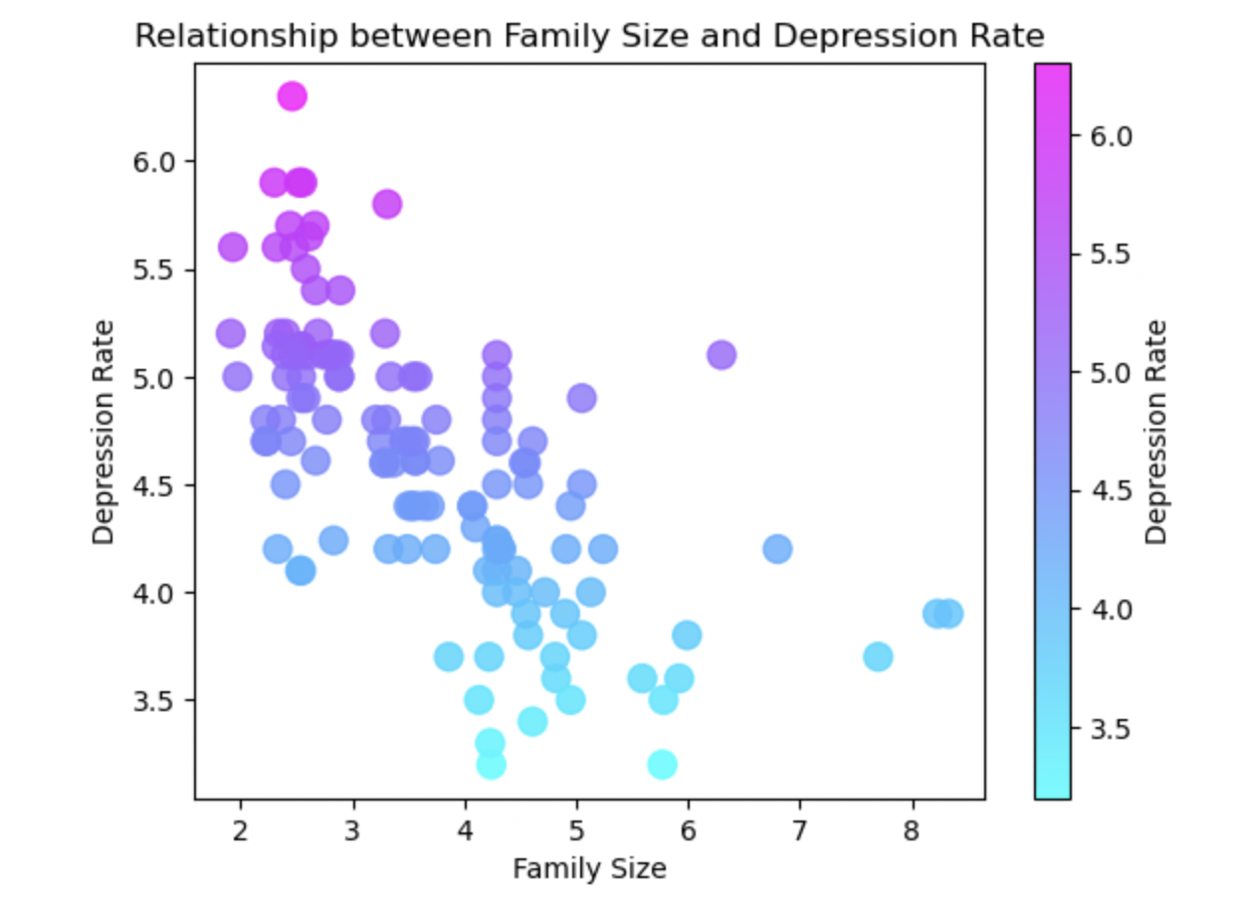

Most important feature
Average of depression of the biggest families is: 3.85
While with the smaller ones is: 5.08

Slide 10

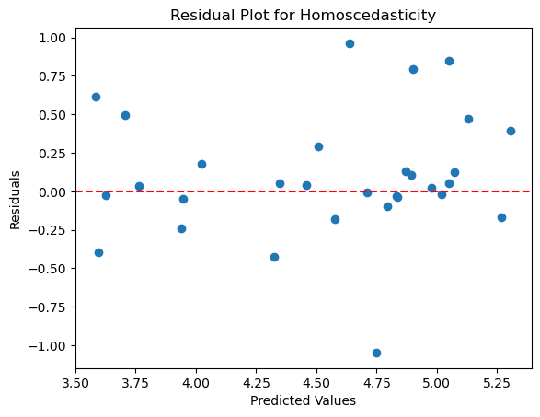
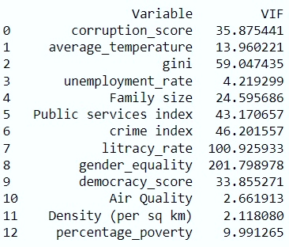
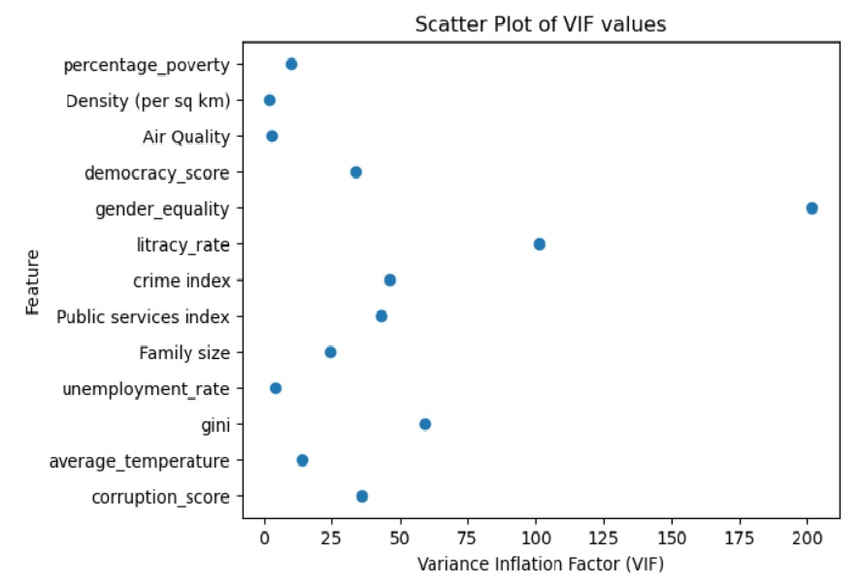
Lessons learned
→ Multicollinearity:

Slide 11

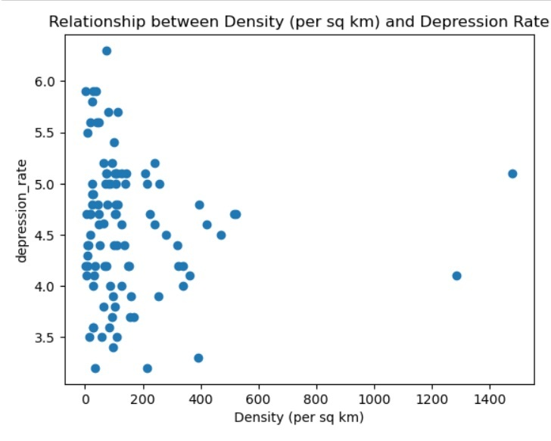
What is next?
Feature selection takes time and more research:
Less aggregating data.
Not use more than one or two indexes.
More detail data: maybe someday arrive to city level.
Change the data according to the user

Slide 12
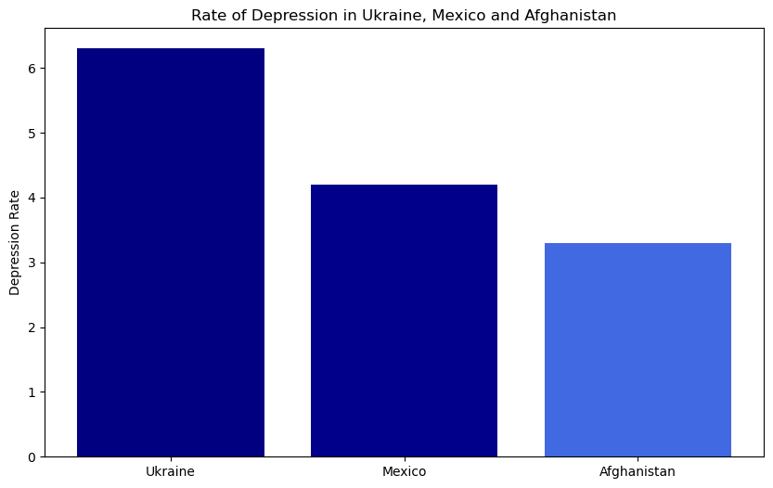



Q & A
Conclusion: Don‘t have pets

Slide 13
Sources
https://www.who.int/data/gho/data/indicators/indicator-details/GHO/estimated-population-based-prevalence-of-depression
https://worldpopulationreview.com/country-rankings/democracy-countries
https://worldpopulationreview.com/country-rankings/gender-equality-by-country
https://www.iqair.com/world-most-polluted-countries
https://data.worldbank.org/indicator/SE.ADT.LITR.ZS
https://worldpopulationreview.com/country-rankings/violent-crime-rates-by-country
https://www.theglobaleconomy.com/rankings/public_services_index/

Slide 14
Sources
Tableau:
https://public.tableau.com/app/profile/ivanna.pivtorak/viz/MidTerm_Theunseencausesofdepression/Story1?publish=yes
Github:
https://github.com/ValeluDelgado/Unseen_causes_of_depression

